Slide 1
AMAZON SALES ANALYSIS
DONE BY
Abinaya T

Slide 2
INTRODUCTION
Sales management has gained importance to meet increasing competition and the need for improved methods of distribution to reduce cost and to increase profits.
Sales management today is the most important function in a commercial and business enterprise.

Slide 3
DATA SET
The data set consists of the 14 rows and 100 columns of data.
The data set consists of the Region ,Country, Item Type, Sales Channel, Order Priority ,Order Date ,Order ID ,Ship Date, Units Sold ,Unit Price ,Unit Cost ,Total Revenue, Total Cost ,Total Profit .

Slide 4
MY DESIGN OF DASH BOARD FOR AMAZON SALES

Slide 5
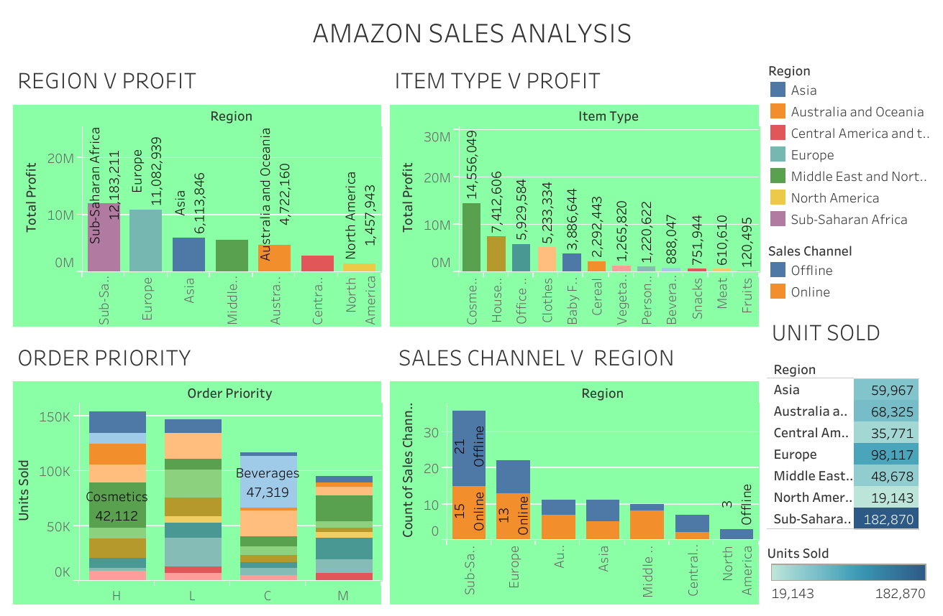

Slide 6
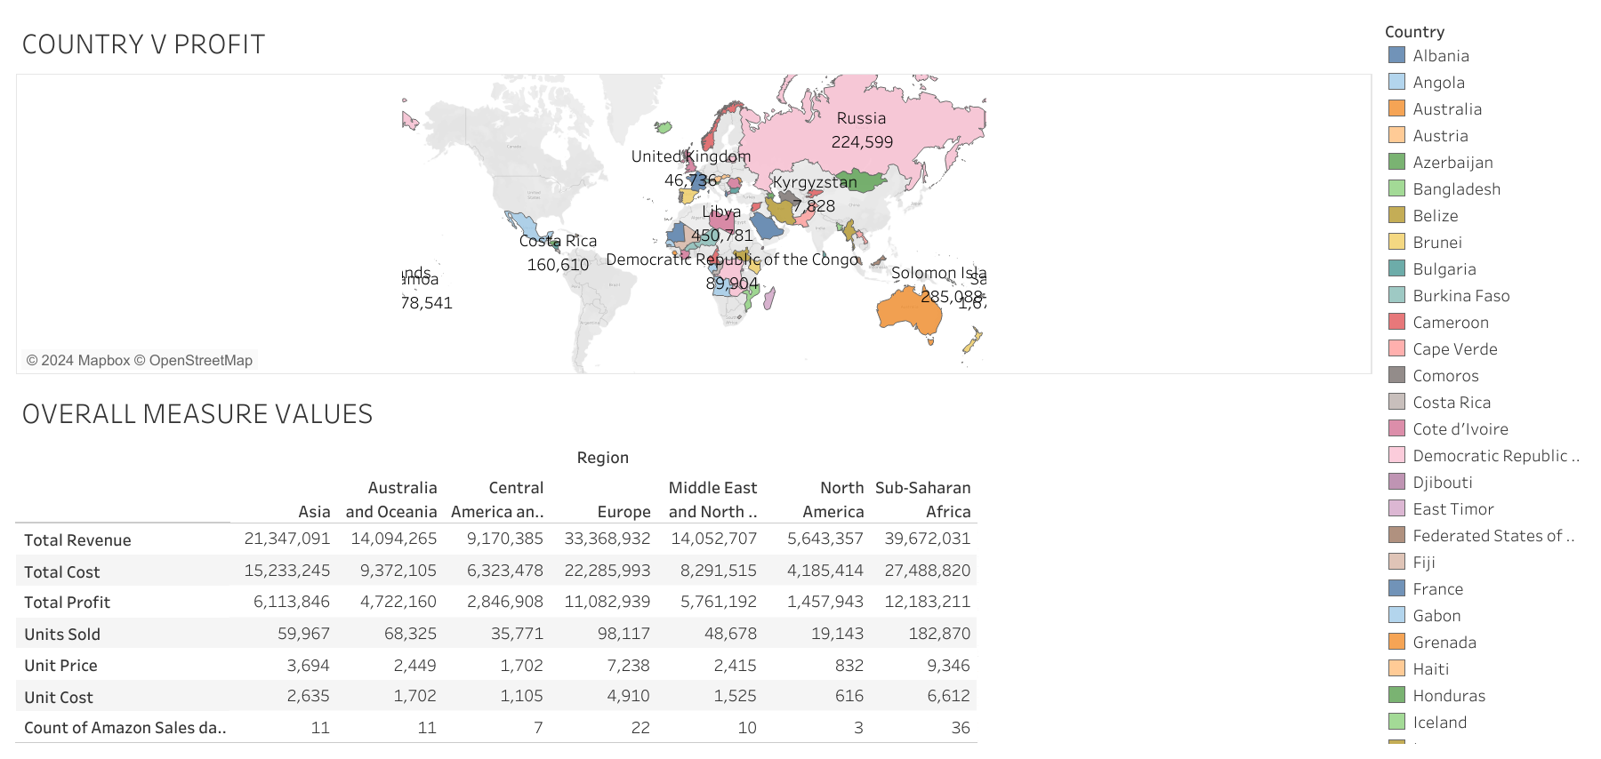

Slide 7
EXPLANATION AND INSIGHT
When we compare the all the region profit the sub-Saharan Africa profit is very high (12,183,211)
The online sales channel is low compared to offline sales channel shows people preferers to offline channel.
Cosmetic products units are sold most.
Sub-Saharan Africa overall market is very high in all the measures.

Slide 8
THANK YOU

Slide 9
UNIFIED MENTOR INTERNSHIP
1 Month of duration- DATA ANALYST
Name: Abinaya T
Internship ID: UMIP3526
E-mail: abinaya951999@gmail.com
Duration: February 1 to March 2

